Slide 1
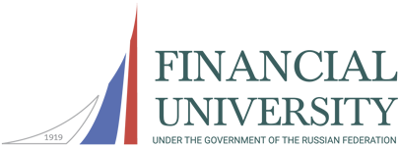
WE VALUE THE PAST, WE BUILD THE FUTURE
Financial University
under the Government of
the Russian Federation
MOSCOW 2021

Slide 2
CENTENNIAL SUCCESS STORY
1919 - Moscow Institute of Finance and Economics was established by the People's Commissariat of Finance of the Russian Soviet Federative Socialist Republic to train public finance officials for the young Soviet state
1934 – reformed into the Moscow Institute of Credit and Economics
1946 – Moscow Institute of Finance and Economics merged with the Moscow Institute of Credit and Economics to form the Moscow Institute of Finance
1991 – State Financial Academy
1992 – Financial Academy under the Government of the Russian Federation
2010 – Financial University under the Government of the Russian Federation

Slide 3
FACTS AND FIGURES
≈ 50 000 students
> 3 000 faculty members, more than 1 800 holding academic degrees and titles
> 170 partner universities in > 50 countries
27 regional branches in Russia
10 campuses in Moscow city area
9 schools
40 teaching and research departments
> 40 research institutes and centers

Slide 4
FINANCIAL UNIVERSITY IN RANKINGS
QS EECA University Rankings 2021 – 157
QS BRICS University Rankings 2020 – 153
QS World University Rankings by Subject 2020 – 351 to 400 in Economics and Econometrics
QS University Rankings by Subject 2020 – 401 to 450 in Business & Management Studies
QS University Rankings by Subject 2020 – 451 to 500 in Social Sciences & Management
1st place in the list of top demanded graduates;
11th place in the list of top-universities with the gratest share of entrepreneurs among graduates
14th out of the Top 100 Russian Universities

Slide 5
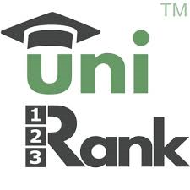
FINANCIAL UNIVERSITY IN RANKINGS
10th place in ARES-2020 – the international university ranking
RUR World University Ranking 2020:
586 th place in World Best Universities list
19th place in Russia Best Universities list
7th place in «Top Universities in Moscow»
16 th place in «Top Russian Universities»

Slide 6
THE RECTOR
PROF. MIKHAIL ESKINDAROV
Doctor of Economics, Professor
Honored Scholar of the Russian Federation
Member of the Russian Academy of Education

Slide 7
NOTABLE ALUMNI
Government officials, members of the Federal Assembly, Central Bank executives, CEOs of Russian and overseas companies, leading experts are among the Financial University graduates.
Anton Siluanov Minister of Finance, First Deputy Chairman of the Government of Russia (2018 – 2020),
Sergei Stepashin Chairman of the Government of Russia (1999), President of the Chamber of Auditors (2000 - 2013)
Aleksandr Khloponin Outstanding statesman and businessman
Mikhail Prokhorov Viktor Gerashchenko
One of the leaders of the Russian business community
Chairman of the State Bank of the USSR and twice Chairman of the Central Bank of the Russian Federation

Slide 8
LIFELONG LEARNING CONCEPT
The Financial University Lyceum and partner high schools target best students for admission to the FinU
58 bachelor degree programs (incl. taught in English)
72 master degree programs (incl. taught in English)
Postgraduate training and doctoral degree programs
Further and business education, incl. MBA programs
Learning modes:
On-campus
On-site/off-site
Distance education
Programs:
Bachelor’s degree
Master’s degree
Postgraduate training
Doctoral degrees
Additional professional training

Slide 9
WIDE RANGE OF SCHOOLS
Higher School of Management
School of IT and Big Data Analysis
School of International Economic Relations
School of Tax, Audit and Business Analysis
School of Social Sciences and Public Communication
School of Economics and Business
School of Finance
School of Law
Pre-University Training Faculty

Slide 10
FUNDAMENTAL AND APPLIED RESEARCH
Financial support of economic and social development
Corporate governance and business strategies
IT and analytical support of economy, management and finance
Economic security
Globalization and institutional modernization of economy
Non-economic factors of sustainable social and economic development

Slide 11
NOTABLE RESEARCH INSTITUTES AND CENTRES
Institute for Digital Economy Development
Blockchain-Lab
Institute for Economic Policy and Economic Security Issues
Institute for International Economy Studies
Institute for Industrial Policy and Institutional Development
Centre for Monetary Policy
Centre for Social and Economic Support to Entrepreneurship “Locomotives of Growth”
Centre for Fiscal Policy and Administration
Political Studies Centre

Slide 12
INTERNATIONALZING THE CURRICULUM
5 study programs fully taught in English: BSc and MSc in Economics and Management
10 BSc and MSc study programs that include modules taught in English
10 study programs accredited by international organizations (ECBE, ACCA, ICAEW)
>90 course units available for the exchange students taught in English
27 joint and double degree programs with leading universities worldwide

Slide 13
INTERNATIONAL COOPERATION
> 170 international partners worldwide
> 60 partners for academic exchange programs
> 400 participants of academic mobility programs annually
Participation in Erasmus+ projects, FIRST+ and other international programs
Fruitful and long-term collaboration with largest national educational agencies (DAAD, CampusFrance, NUFFIC etc.)
Conduction of R&D activities supported by international funding and grants

Slide 14
INTERNATIONAL STUDENTS
Over 1 500 international students from 64 different countries
Pre-University Training Faculty for initial training of foreign natioinals Russian language & professional definitions courses
International Office facilitates academic activities and social adaptation of international students
Mobilization of leading foreign experts to join the FinU
International Professor Program – InterProfProject
Visiting Professor Program

Slide 15
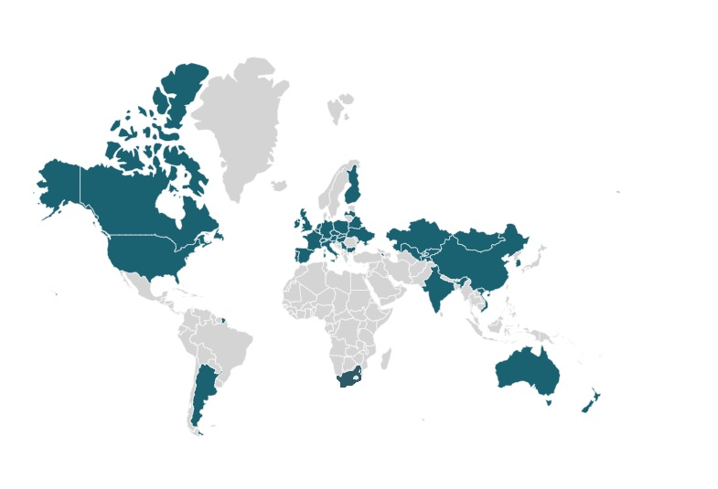
PARTNER UNIVERSITIES MAP

Slide 16
INTERNATIONAL PROJECTS: best practices
Russian Language Summer Schools – held annually and aimed to promote Russian language and culture among the foreign nationals
Joint Research Project w/ Worchester Polytechnic Institute (USA) – students of two universities create teams to unite their technical and economic skills to develop the problem-based projects for the national economies
Introductory Visits – short-term student exchange programs with University of Cologne (Germany), University of Turin (Italy) and Kindai University (Japan) to provide students with unique experience of professional training and collaboration with their peers overseas

Slide 17
STUDENT LIFE AND FINU INFRASTRUCTURE
Student Residence Hall at FinU campus in the center of Moscow
3 sports and recreation centres equipped for 20 sports disciplines
Swimming pool
2 movie theaters
Library & Information Center
Congress Hall
Conference rooms
An outpatient clinic
Recreational facility in the Moscow Region

Slide 18
Our Contacts:
+ 7 499 249 5249, + 7 499 943 9417
inter@fa.ru, academy@fa.ru
LET’S BUILD THE FUTURE TOGETHER!

