Slide 1
SAINT-PETERSBURG STATE UNIVERSITY OF AEROSPACE INSTRUMENTATION

Slide 2
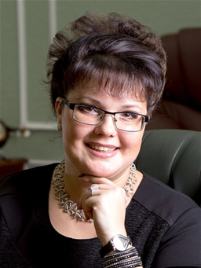
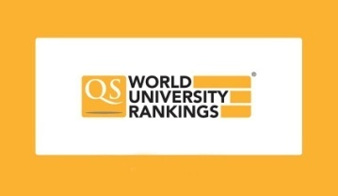
Globally recognized experience
The University was founded in hard early forties and it still keeps moving upwards. Within almost 80 years the University has grown from a narrowly-specialized restricted admission institute to become a major research and education center.
In 2018 SUAI entered Forbes’ List of Top 100 of the Best Universities in Russia and has been strengthening it’s position in it since then. SUAI in entering the number of best universities according to the QS EECA University Rankings 2020 and is holding high positions in ARES
RECTOR
YULIA A. ANTOKHINA
Doctor of Economics, Professor,
Laureate of the Prize of the Government of the Russian Federation in the field of education, Honorary Worker of Higher Professional Education of the Russian Federation

Slide 3
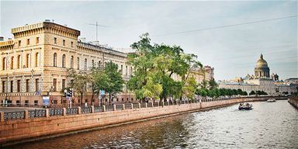
SUAI in Brief
12 institutes and faculties,
over 40 departments,
132 educational programs
15000 students
about 1000 foreign students
three comfortable dormitories
three locations; two are in historical St.Petersburg

Slide 4
Levels of Education at SUAI
SUAI offers the following levels of education: Higher education:
Bachelor's programs
Master's programs
Specialist programs
Postgraduate programs
Secondary vocational education:
Training of qualified industrial and office workers
Training of mid-level professionals
Professional development and retraining programs at the Faculty of additional professional education.

Slide 5
Institutes, Faculties and Schools
Institute of Aerospace Instruments and Systems (Institute №1)
Institute of Radio Engineering, Electronics and Communications (Institute №2)
Institute of Innovative Technologies in Electromechanics and Robotics (Institute №3)
Institute of Computing Systems and Programming (Institute №4)
Institute of Information Systems and Information Security (Institute №5)
Faculty of Humanities (Faculty №6)
Institute of Fundamental Training and Technological Innovations
Institute of Entrepreneurship Technologies (Institute №8)
Faculty of Law (Faculty №9)
School of Engineering
Institute of Continuous and Distance Education
Faculty of Additional Professional Education
Faculty of Secondary Vocational Education

Slide 6
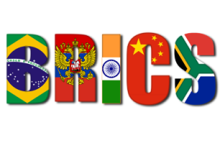
International Activities
SUAI participates in European educational and research programs:
Erasmus +
Interreg
FIRST +
SUAI is a member of the UNITWIN/UNESCO Chair Program and is part of the UNESCO chair Partnership in the field of ICT application in education.
SUAI is an active member of a number of international associations and consortia, such as:
International Society of Automation (ISA)
International Telecommunication Union (ITU)
European Space Research and Technology Centre of the European Space Agency (ESTEC)
Advanced Research & Technology for Embedded Intelligent Systems Platform (ARTEMIS)
SpaceWire Work Group
International CDIO Initiative
Finnish-Russian University Cooperation in Telecommunications Association (FRUCT)
Association of Rectors of Transport Universities of the BRICS
Association of Rectors of Transport Universities in Russia and China
The “Belt and Road” Aerospace Innovation Alliance (BRAIA)
and others

Slide 7
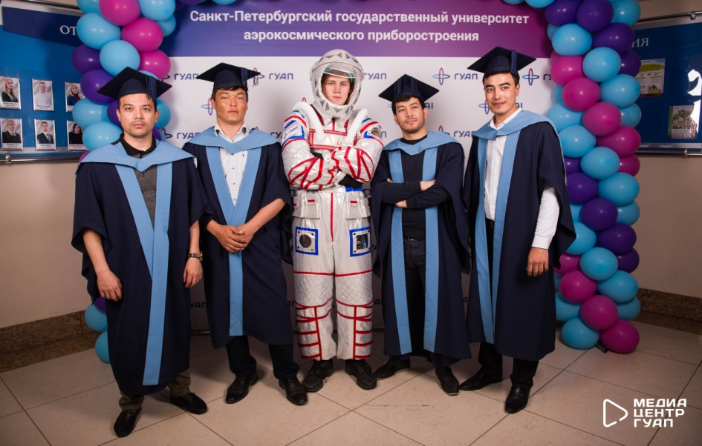
Education for International Students
Year | 17/18 | 18/19 | 19/20
Number of International Students | 864 | 900 | 1046
Number of Countries | 30 | 29 | 28
Higher and Vocational Education
Pre-University training
International Student Mobility Programs

Slide 8
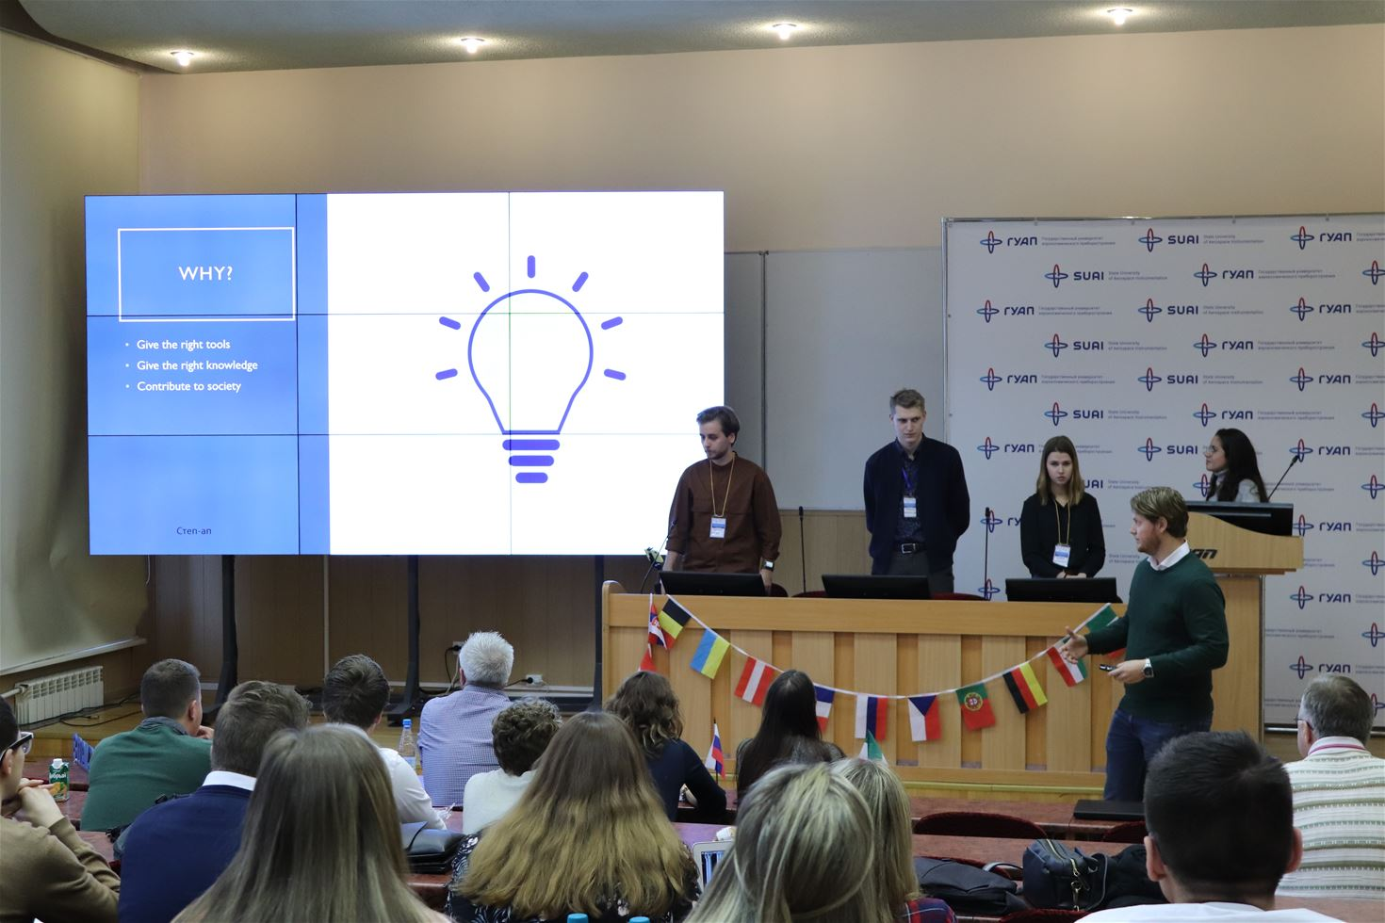
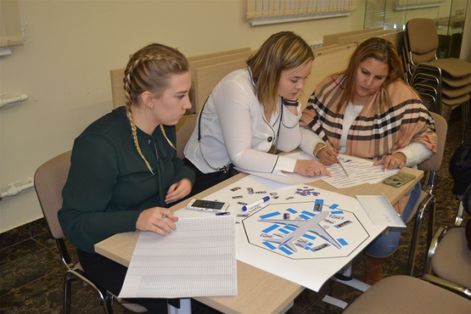
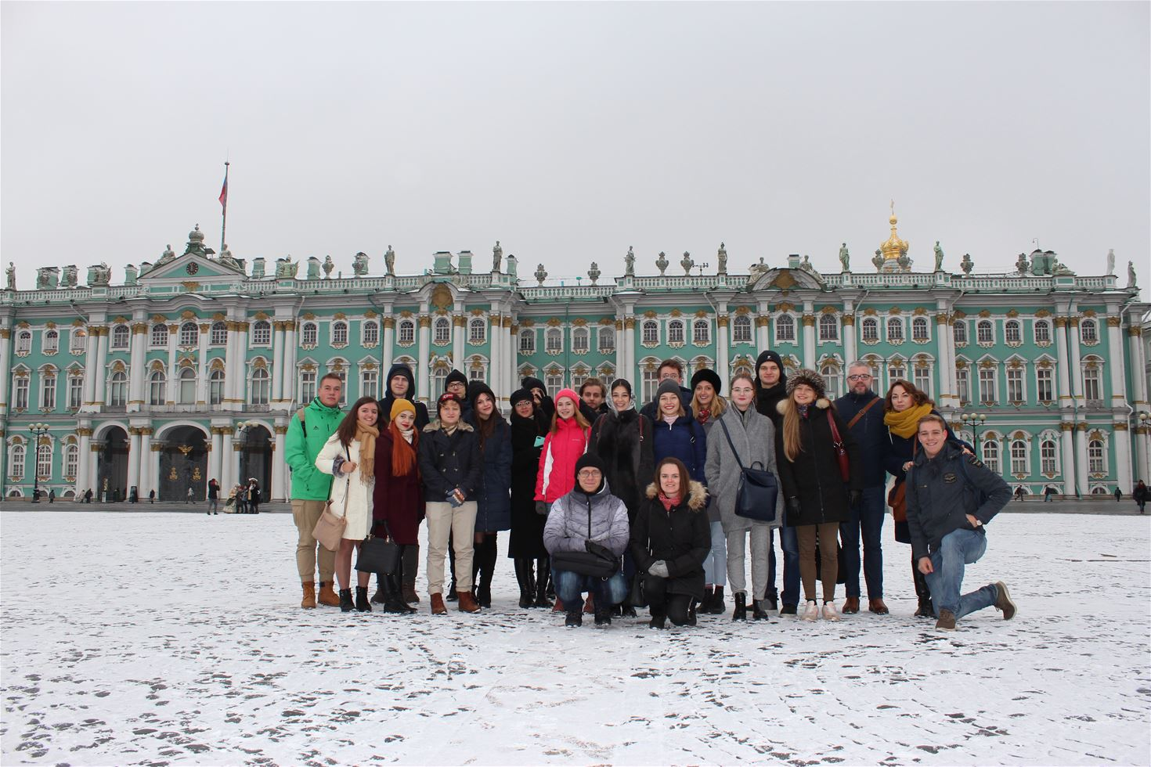
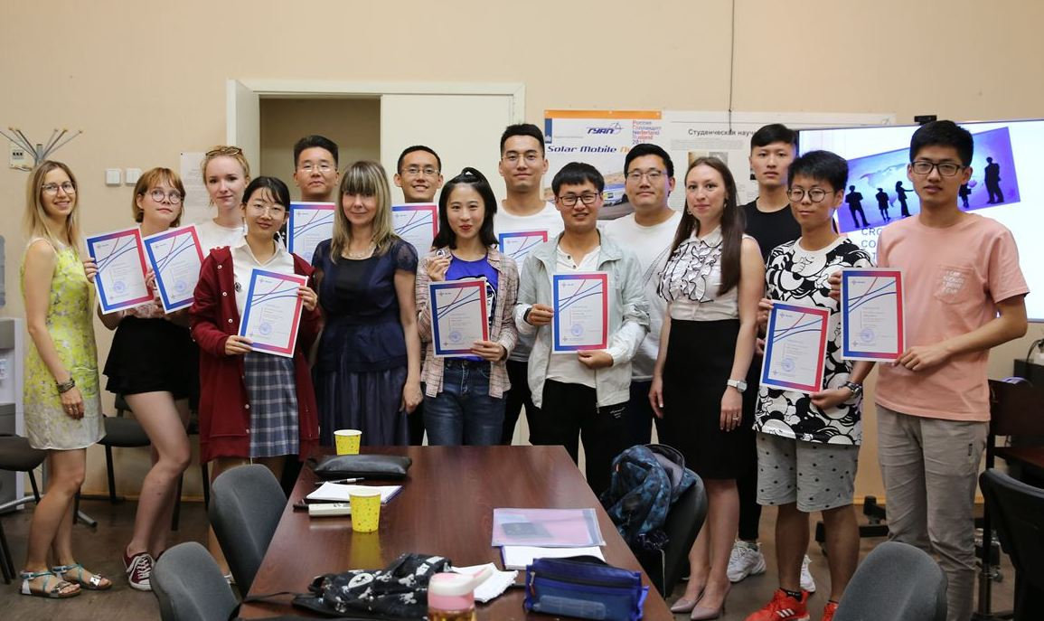
International Activities for Students
International Summer/Winter Schools
International Business School
Carousel Business Project
International seminars "Intelligent models and methods of research of aviation transport systems“ and others

Slide 9
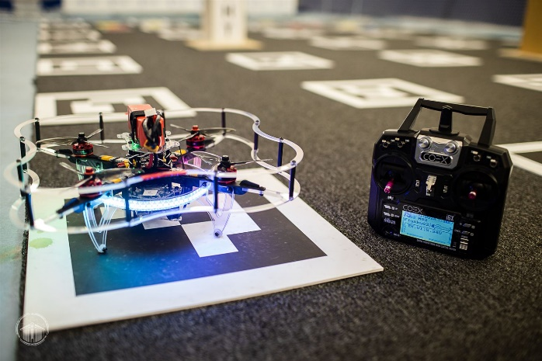
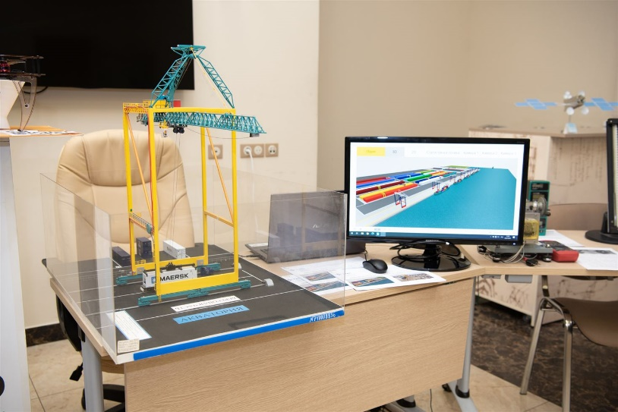
Scientific Activities
Main research areas:
Transport and space systems
Information and telecommunication systems
Radio engineering, electronics and communications
Innovative technologies in electrical engineering
and energy
Computer systems and programming
Humanities in the Information Society
Digital economy
Innovation and investment activity of high-tech industries
Actual problems of law and information and legal policy of the state
Problems of philosophy, religion and culture

Slide 10
Main Directions of Scientific Research
Priority directions of development
of scientific and technological complex in Russia
Fields of knowledge

Slide 11
Cooperation with Industry
Integration with the leading domestic and international research centers and knowledge-intensive enterprises in the Aerospace Industry as well as large-scale collaboration with businesses provide the SUAI a position of confidence in the educational market and a huge potential for future development.
SUAI comprises about 20 enterprise-based departments, partners to leading companies in the North-West Aerospace Cluster.
Interaction with businesses and organizations within the Cluster is conducted on the “full circle” basis — from basic research to experimental development and prototyping.
There are joint Nokia-SUAI laboratories, the SUAI-EMC permanent working groups. Besides, the University develops long-term projects with Siemens-Networks, Cadence, and the European Space Technology Centre, the ESTEC.

Slide 12
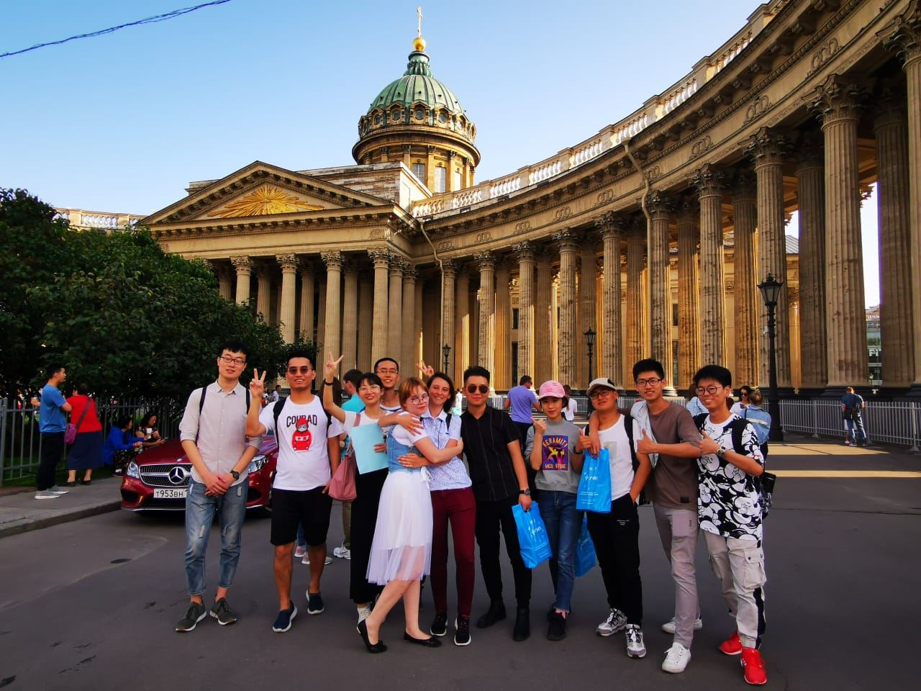
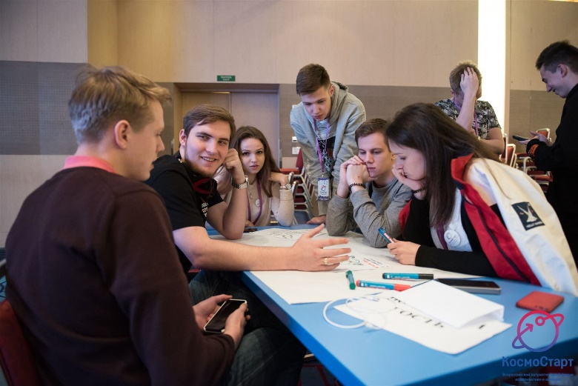
Proposals for Cooperation
Short-term and long-term student and teacher exchanges
Summer/winter schools on different topics including
- Russian language and culture
- Cross-cultural communication
- World economy
and others.
Joint educational programs
Joint research projects
Participation in conferences and seminars
Distance courses

Slide 13
SAINT-PETERSBURG STATE UNIVERSITY
OF AEROSPACE INSTRUMENTATION (SUAI)
Department for International Affairs
Address: 67, Bolshaya Morskaya str., Saint Petersburg,
190000, Russia
Phone: +7 (812) 312-09-37
+7 (812) 315-77-78
E-mail: int@aanet.ru
http://suai.ru/

